Slide 1

Elementary Statistics
Thirteenth Edition
Chapter 4
Probability
Copyright © 2018, 2014, 2012 Pearson Education, Inc. All Rights Reserved

Slide 2
Probability
4-1 Basic Concepts of Probability
4-2 Addition Rule and Multiplication Rule
4-3 Complements and Conditional Probability, and Bayes’ Theorem
4-4 Counting
4-5 Probabilities Through Simulations (available at TriloaStats.com)

Slide 3
Key Concept (1 of 2)
In this section we present the addition rule as a tool for finding P(A or B), which is the probability that either event A occurs or event B occurs (or they both occur) as the single outcome of a procedure. The word “or” in the addition rule is associated with the addition of probabilities.

Slide 4
Key Concept (2 of 2)
This section also presents the basic multiplication rule used for finding P(A and B), which is the probability that event A occurs and event B occurs. The word “and” in the multiplication rule is associated with the multiplication of probabilities.

Slide 5
Compound Event
Compound Event
A compound event is any event combining two or more simple events.

Slide 6
Addition Rule
Notation for Addition Rule
P(A or B) = P(in a single trial, event A occurs or event B occurs or they both occur)

Slide 7
Intuitive Addition Rule
To find P(A or B), add the number of ways event A can occur and the number of ways event B can occur, but add in such a way that every outcome is counted only once. P(A or B) is equal to that sum, divided by the total number of outcomes in the sample space.

Slide 8
Formal Addition Rule
P(A or B) = P(A) + P(B) − P(A and B)
where P(A and B) denotes the probability that A and B both occur at the same time as an outcome in a trial of a procedure.

Slide 9
Disjoint Events and the Addition Rule
Disjoint (or mutually exclusive)
Events A and B are disjoint (or mutually exclusive) if they cannot occur at the same time. (That is, disjoint events do not overlap.)

Slide 10
Example: Disjoint Events (1 of 2)
Disjoint events:
Event A—Randomly selecting someone for a clinical trial who is a male
Event B—Randomly selecting someone for a clinical trial who is a female (The selected person cannot be both.)

Slide 11
Example: Disjoint Events (2 of 2)
Events that are not disjoint:
Event A—Randomly selecting someone taking a statistics course
Event B—Randomly selecting someone who is a female (The selected person can be both.)

Slide 12
Summary
Here is a summary of the key points of the addition rule:
To find P(A or B), first associate the word or with addition.
To find the value of P(A or B), add the number of ways A can occur and the number of ways B can occur, but be careful to add without double counting.

Slide 13
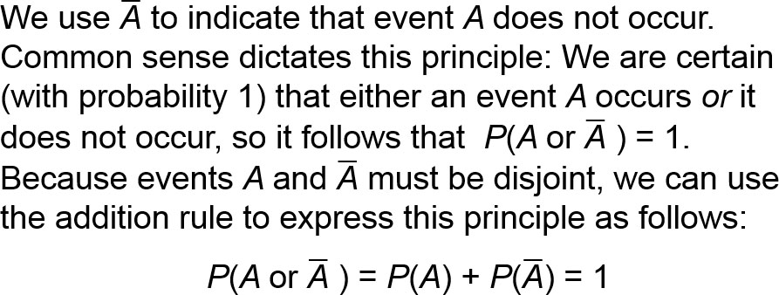
Complementary Events and the Addition Rule

Slide 14
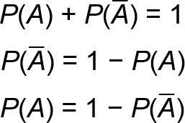
Rule of Complementary Events

Slide 15
Example: Sleepwalking (1 of 2)
Based on a journal article, the probability of randomly selecting someone who has sleepwalked is 0.292, so P(sleepwalked) = 0.292 (based on data from “Prevalence and Comorbidity of Nocturnal Wandering in the U.S. General Population,” by Ohayon et al., Neurology, Vol. 78, No. 20). If a person is randomly selected, find the probability of getting someone who has not sleepwalked.

Slide 16
Example: Sleepwalking (2 of 2)
Solution
Using the rule of complementary events, we get
P(has not sleepwalked) = 1 − P(sleepwalked)
= 1 − 0.292 = 0.708
The probability of randomly selecting someone who has not sleepwalked is 0.708.

Slide 17
Multiplication Rule
Notation
P(A and B) = P(event A occurs in a first trial and event B occurs in a second trial)
P(B | A) represents the probability of event B occurring after it is assumed that event A has already occurred.

Slide 18
Intuitive Multiplication Rule
To find the probability that event A occurs in one trial and event B occurs in another trial, multiply the probability of event A by the probability of event B, but be sure that the probability of event B is found by assuming that event A has already occurred.

Slide 19
Formal Multiplication Rule
P(A and B) = P(A) ⋅ P(B | A)

Slide 20
Independence and the Multiplication Rule
Independent
Two events A and B are independent if the occurrence of one does not affect the probability of the occurrence of the other. (Several events are independent if the occurrence of any does not affect the probabilities of the occurrence of the others.) If A and B are not independent, they are said to be dependent.

Slide 21
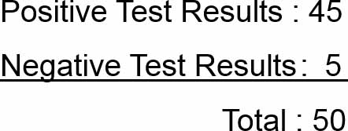
Example: Screening Drugs and the Basic Multiplication Rule (1 of 6)
50 test results from the subjects who use drugs are shown below:

Slide 22
Example: Screening Drugs and the Basic Multiplication Rule (2 of 6)
a. If 2 of these 50 subjects are randomly selected with replacement, find the probability the first selected person had a positive test result and the second selected person had a negative test result.
b. Repeat part (a) by assuming that the two subjects are selected without replacement.

Slide 23


Example: Screening Drugs and the Basic Multiplication Rule (3 of 6)
Solution
a. With Replacement: First selection (with 45 positive results among 50 total results):
Second selection (with 5 negative test results among the same 50 total results):

Slide 24

Example: Screening Drugs and the Basic Multiplication Rule (4 of 6)
Solution
We now apply the multiplication rule as follows:
P(1st selection is positive and 2nd is negative)

Slide 25

Example: Screening Drugs and the Basic Multiplication Rule (5 of 6)
Solution
b. Without Replacement: Without replacement of the first subject, the calculations are the same as in part (a), except that the second probability must be adjusted to reflect the fact that the first selection was positive and is not available for the second selection. After the first positive result is selected, we have 49 test results remaining, and 5 of them are negative.

Slide 26

Example: Screening Drugs and the Basic Multiplication Rule (6 of 6)
Solution
P(1st selection is positive and 2nd is negative)

Slide 27
Sampling
In the world of statistics, sampling methods are critically important, and the following relationships hold:
Sampling with replacement: Selections are independent events.
Sampling without replacement: Selections are dependent events.

Slide 28
Treating Dependent Events and Independent
5% Guideline for Cumbersome Calculations
When sampling without replacement and the sample size is no more than 5% of the size of the population, treat the selections as being independent (even though they are actually dependent).

Slide 29
Example: Drug Screening and the 5% Guideline for Cumbersome Calculations (1 of 3)
Assume that three adults are randomly selected without replacement from the 247,436,830 adults in the United States. Also assume that 10% of adults in the United States use drugs. Find the probability that the three selected adults all use drugs.

Slide 30
Example: Drug Screening and the 5% Guideline for Cumbersome Calculations (2 of 3)
Solution
Because the three adults are randomly selected without replacement, the three events are dependent, but here we can treat them as being independent by applying the 5% guideline for cumbersome calculations. The sample size of 3 is clearly no more than 5% of the population size of 247,436,830.

Slide 31
Example: Drug Screening and the 5% Guideline for Cumbersome Calculations (3 of 3)
Solution
We get P(all 3 adults use drugs)
= P(first uses drugs and second uses drugs and third uses drugs)
= P(first uses drugs) · P(second uses drugs) · P(third uses drugs)
= (0.10)(0.10)(0.10)
= 0.00100
There is a 0.00100 probability that all three selected adults use drugs.

Slide 32
Redundancy: Important Application of the Multiplication Rule
The principle of redundancy is used to increase the reliability of many systems.
Our eyes have passive redundancy in the sense that if one of them fails, we continue to see. An important finding of modern biology is that genes in an organism can often work in place of each other. Engineers often design redundant components so that the whole system will not fail because of the failure of a single component.

Slide 33
Example: Airbus 310; Redundancy for Better Safety (1 of 5)
Modern aircraft are now highly reliable, and one design feature contributing to that reliability is the use of redundancy, whereby critical components are duplicated so that if one fails, the other will work. For example, the Airbus 310 twin-engine airliner has three independent hydraulic systems, so if any one system fails, full flight control is maintained with another functioning system.

Slide 34
Example: Airbus 310; Redundancy for Better Safety (2 of 5)
For this example, we will assume that for a typical flight, the probability of a hydraulic system failure is 0.002.
a. If the Airbus 310 were to have one hydraulic system, what is the probability that the aircraft’s flight control would work for a flight?
b. Given that the Airbus 310 actually has three independent hydraulic systems, what is the probability that on a typical flight, control can be maintained with a working hydraulic system?

Slide 35
Example: Airbus 310; Redundancy for Better Safety (3 of 5)
Solution
a. The probability of a hydraulic system failure is 0.002, so the probability that it does not fail is 0.998. That is, the probability that flight control can be maintained is as follows:
P(1 hydraulic system does not fail) = 1 − P(failure)
= 1 − 0.002
= 0.998

Slide 36
Example: Airbus 310; Redundancy for Better Safety (4 of 5)
Solution
b. With three independent hydraulic systems, flight control will be maintained if the three systems do not all fail. The probability of all three hydraulic systems failing is 0.002 · 0.002 · 0.002 = 0.000000008.
It follows that the probability of maintaining flight control is as follows:
P(it does not happen that all three hydraulic systems fail) = 1 − 0.000000008 = 0.999999992

Slide 37
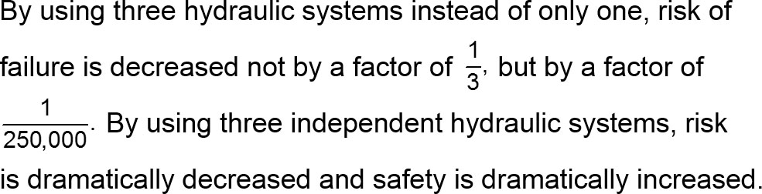
Example: Airbus 310; Redundancy for Better Safety (5 of 5)
Interpretation
With only one hydraulic system we have a 0.002 probability of failure, but with three independent hydraulic systems, there is only a 0.000000008 probability that flight control cannot be maintained because all three systems failed.

Slide 38
Summary of Addition Rule and Multiplication Rule
Addition Rule for P(A or B): The word or suggests addition, and when adding P(A) and P(B), we must add in such a way that every outcome is counted only once.
Multiplication Rule for P(A and B): The word and for two trials suggests multiplication, and when multiplying P(A) and P(B), we must be sure that the probability of event B takes into account the previous occurrence of event A.

